Slide 1
SCUA General meeting
January 12, 2022

Slide 2
Pre-arrival responsibilities
CALLING YOUR PARTNER RULE OF THUMBS:
If you wonder or think to yourself why your partner has not called you, it is time to call your partner
If you contacted your partner via text or email and have not received a response, it is time to dial the phone.
Some members may not have text on their phone or check email on a regular basis.
No requirement on which umpire must initiate the contact.

Slide 3
Pre-game responsibilities
Arrive at game site at least 30 minutes prior to game time.
Always bring your plate gear – you may need to work the plate if your partner is late, gets injured or becomes ill
Be respectful of school grounds.
Treat school grounds as you would like others to treat your property.
Observe speed limits in parking lots.
Park in designated areas.
Take everything away you brought with you (no trash).
No alcohol, tobacco products or e-cigs on school grounds.
Conduct a thorough Pre-Game

Slide 4
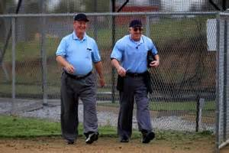
Pre-game responsibilities
Walk to the field together with your partner.
Except for emergencies, leave your cell phone in the car or turn it off.
WALK OFF THE FIELD TOGETHER AND LEAVE PARKING LOT TOGETHER.

Slide 6
What I Learned Over the Summer
It takes a new catcher 1-2 innings to get used to artificial turf.
Target practice anyone?
It is possible for a pitch in fast pitch softball to hit the umpire on top of the head.
Just how far one can fake lineup card management before it comes back to bite.
The term “Sh!t Show”.
Always watched
Decorum, Optics, Respect
Notes:
Smoking weed in the lot
Staying within your area of jurisdiction / overriding partner / respecting one another.
If your intent is to ride into a game on your white horse, fluff your feathers, and ride away with an overfed ego – not the place for you

Slide 7
Game Management
Large and Complex Subject
Many areas of game management
From arrival, pregame, lineup, field conditions, equipment, coaches, players, fans, media, calls, rules, demeanor, adversity, communication, control, game ending, post game, etc.
Where does it start?
It Starts With You!
And in every facet of your game.
Does not end with you, but it entails what you can control.
And it is how you conduct and control each item within your purview that will make all the difference.
Notes:
Most requested topic. Get more into game management and handling later, but it starts with you. How you handle yourself, show respect, and manage the game.
Does not end with you, but it entails what you can control. And it is how you conduct and control each item within your purview that will make all the difference.

Slide 8
Post Game Integrity Truism
Did you do the best you could?
Did you look after the person working with you?
Or did you undercut them to take the heat off of you or to make you look better?
Did you leave the game with your honor intact?
Or were your actions out of spite or to show everyone your “show”?
Did you make all your calls in good faith?
Or did you make up the rules to fit the call?
Notes:
What are some of the key questions we can ask ourselves on if we had a successful game.

Slide 9
Back to Basics - Uniform
The Very First Impression: Uniform
Look the Part
Clean, Neat, Polished
Dress Alike
“An unkept or worn uniform tells people that you don’t take your role in the game seriously; and if you don’t take it seriously, they won’t take your authority seriously”.
Make sure your entire countenance & demeanor scream out professionalism and authority
Notes:
You really do only get one chance to make a first impression.
Everything from the clothes you wear to your posture, gestures, and facial expressions must convince everyone that you are ready to officiate and that you take your job seriously.

Slide 10
SCUA Softball Official’s Uniform
Shirt
Light Blue
Pullover
No Logo
Blue and White Collar and Sleeves

Slide 11
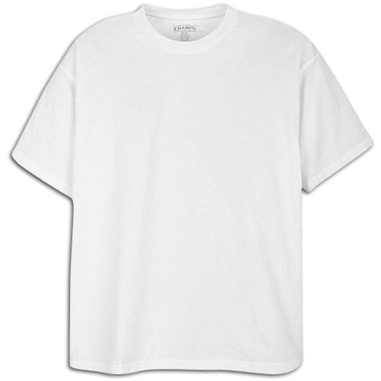
SCUA Softball Official’s Uniform
Undershirts
White Shirt: Must not have logos or print
White Undershirt
Navy Blue Undershirt/Long Sleeve
No exposed undersleeves
Long Sleeve: worn under jacket only

Slide 12
SCUA Softball Official’s Uniform
Jacket
Navy Blue (light blue stripes w/ white trim)

Slide 13
SCUA Softball Official’s Uniform
Slacks and Belt
Heather Grey Slacks
Black Leather Belt
(No large buckles)
Clean and Pressed

Slide 14
What to Watch Out for with Pants
Don’t Let This Happen To You.
Double Stitch Your Pants

Slide 15
SCUA Softball Official’s Uniform
Hats
Navy Blue
Wool / Fitted
Solid Blue / Blank
SCUA Lettering OK if both umps match
Worn properly at all times
Be sure to match your partner

Slide 16
SCUA Softball Official’s Uniform
Plate Shoes (Black)
Steel Toe, Metatarsal Guard
Base Shoes (Black)
Turf shoe
Example
Clean and Polished!

Slide 17
Uniform/Equipment Professionalism
All equipment held on person
No equipment to be hung on fence

Slide 18
Softball Officiating Focus
Focus on Professionalism, Consistency, Knowledge.
“The science of officiating is knowing the rules. The art of officiating is knowing what to do when the game changes. You don’t change the rules, but you change how you react.”
Good Rule Knowledge = Confidence = Enjoyment
Explaining Rules Properly; Making the Big Call
Weak Rule Knowledge = Lack of Confidence
Trying To Fake It, Applying non HS rules, Apprehensive to Make a call.

Slide 19
Rules Knowledge
Faking It Examples:
Pitcher Must Have Both Feet On Pitcher’s Plate Prior To Pitching
FALSE – NFHS ALLOWS NON-PIVOT FOOT TO BE IN CONTACT WITH OR BEHIND PLATE
Substitutes cannot re-enter (come in, go out, come back in); only starters can re-enter..
FALSE – SUBSTITUTES CAN RE-ENTER
Courtesy Runner – Use last completed at bat or anyone no longer in the game.
FALSE
Intentional Walk – Pitches have to be thrown.
NO – THEY NO LONGER HAVE TO BE THROWN. REQUEST CAN BE MADE BY PITCHER, CATCHER, OR COACH
Batter who enters the batters box with her shirt not tucked is assessed a strike.
FALSE

Slide 20
Rules Knowledge
Faking It Examples:
Bat left over Plate, Pitch outside of strike zone – Ball.
NO – IT IS A STRIKE. HOLDING THE BAT IN THE STIKE ZONE IS CONSIDERED A BUNT ATEMPT. IN ORDER TO TAKE A PITCH, THE BAT MUST BE WITHDRAWN (PULLED BACK)
An eligible player who is not listed on the lineup card cannot participate in the game.
FALSE
Pitcher can leap if she cannot reach the plate otherwise.
NO – LEAPING IS ILLEGAL REGARDLESS
The Hands Are Part Of The Bat (My Favorite)
NO – HANDS ARE NOT PART OF THE BAT

Slide 21
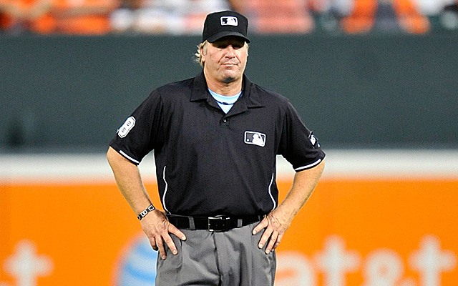
Approachability
Arrogance / Unapproachable
Confidence / Approachable

Slide 22
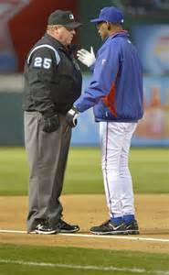
Approachability
Approachability is critical
Allow a coach to ask questions;
TIP: Set the stage in your pregame meeting

Slide 23
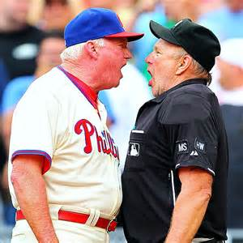
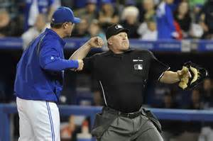
Approachability
Avoid confrontation – it takes two to have an argument.

Slide 24
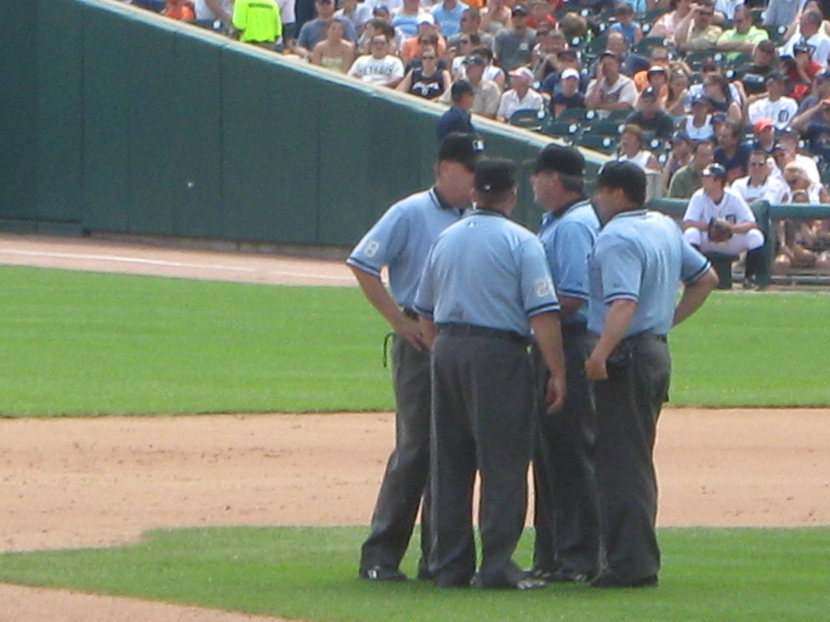
Approachability
Let the coach have his/her say; listen carefully;
If it makes sense, be willing to check with your partner he/she may well have a different angle that will give you additional information.

Slide 25
Respect
Everybody wants and desires respect;
How you carry yourself says more about you than anything you can say verbally.
People will respect the uniform, but they will not respect the person if you do not respect others, the game, or your role seriously.
Remember this is NOT your showcase
Respect starts with you.
Respect the game, respect your partner

Slide 26
Confidence and Strength
Strong Rules Knowledge and Mechanics
Shoulders back and head up
Slouching with head down; avoiding eye contact = timid
Smiles; Talks to partner
Firm handshake with coach
Maintaining eye contact
Signaling sharply
Listening carefully
Tone of Voice - Appropriate, Calm, Professional
Keeping hands at your sides or behind back.
Hands on hips or crossing arms = arrogance/overconfidence
What is one other place we do not want to place our hands?

Slide 27
Professionalism
Why Are We Here
Here for enforcing rules tempered with reason.
NOT here to be officious, overbearing or a tough guy/gal.
Want More Visibility / Want More Respect ?
Being humble is the exact opposite of being arrogant.
Humble does NOT equal weakness
Being humble is the first step to being virtuous
The arrogant official might be more visible, but
The one with a dash of humility will be more respected

Slide 28
Professionalism Is Its Own Reward
If you conduct yourself in a first-class manner you will come away with a higher opinion of yourself.
We want you to succeed. If you succeed, we succeed.
In turn, that will affect how you carry yourself on the field.
Also affects how you are perceived on the field
Players, coaches, and fans feel the presence of officials who handle themselves that way and your job will become easier and more enjoyable.

Slide 29
It All Starts With You!

